Slide 1
Avoiding nsf through appropriate budgeting
Presented by
Norma Allen
2/9/09
(Revised for reserves 11/8/11)

Slide 2
Who and what are Affected by NSF Reject?
NSF is set to reject in Banner for:
Level 5 Organization and Fund Level 3 for I&G funds
Level 5 Organization and Fund Level 3 for Unrestricted Research indices
Level 5 Organization and Fund Level 3 Unrestricted Public Service indices including non-endowed spending indices
Athletics at Organization Level 6
Notes:
Note for the HSC: for the College of Nursing, College of Pharmacy, Health Science Library Informatics Center, and HSC Administration in addition to the Organization Level 5 and Fund Level 3 Banner checks, HSC Financial Services manually checks for NSF status at the index level for many departments.

Slide 3
How does Banner Calculate NSF?
Total Accumulated Expense Budget Less: Fiscal YTD Actual Less: Fiscal YTD Commitments Less: Pending Transactions =Budget Available for Spending
Notes:
Total Accumulated Expense Budget
Less: Fiscal YTD Actual Less: Fiscal YTD Commitments (encumbrances/reservations) Less: Pending Transactions [This does not include internal PRs]
= Budget Available for Spending

Slide 4
Transactions subject to NSF
All documents initiated in Banner, including:
Journal Vouchers
Invoices
Requisitions from LoboMart
Purchase Orders
General Encumbrances
P-card reallocations

Slide 5
Transactions not subject to NSF
Any feeds into Banner:
- Payroll - P-card - Banner tax - Telecommunications - Internal Sales Feeds, such as Bookstore, etc.
Notes:
Please note: transactions that are not subject to NSF checking can place the unit in deficit if there is not enough available budget to fund the transaction. Reconcile your feeds from Banner monthly.

Slide 6
Account Codes do not Affect NSF
Moving budgeted funds from one account code to another within:
an index
fund level 3
Organization level 5
will never relieve NSF status

Slide 7
How to tell you are in NSF Status
Initiator of document will see an error message
Notes:
Initiator of document will see an error message while attempting to complete the document if the organization is already in an NSF condition (insufficient budget to fund actual transaction). You cannot complete DPEZs and requisitions in Banner if the organization is already in an NSF condition.

Slide 8
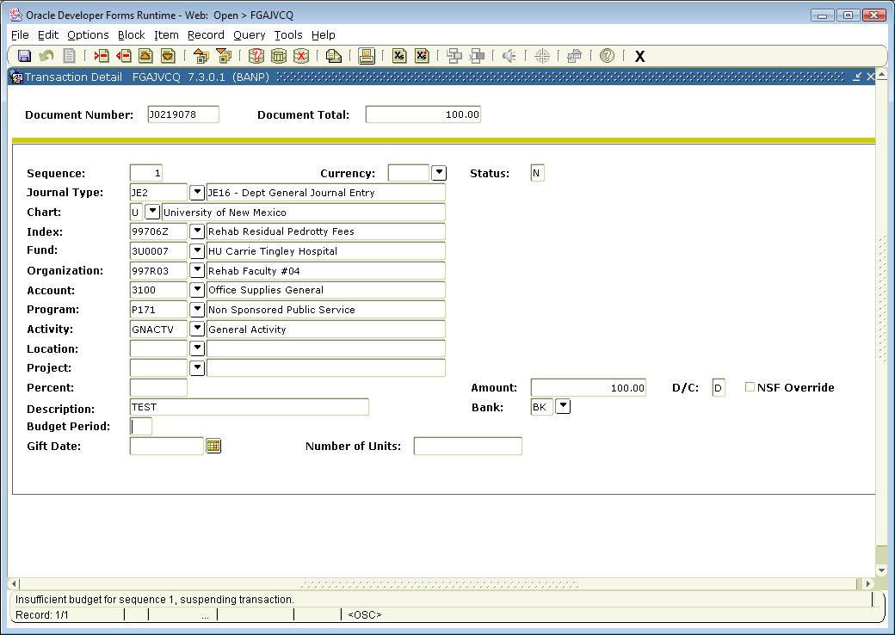
NSF Status -JV
Notes:
. If the status of a JV is “N”, the index is in NSF status and the JV will be routed to the NSF queue.
You also have a note at the bottom of the page.

Slide 9
How to tell you are in NSF Status
The document is routed to an NSF approval queue instead of the regular approval queues in Central Accounting.
If document is suspended due to NSF, it will be in the “NSF-Over Budget” queue.
Notes:
If the organization spends into a deficit while a document is pending approval, the document will be routed to an NSF approval queue instead of the regular approval queues in Central Accounting.
If document is suspended due to NSF, it will be in the “NSF-Over Budget” queue.
Initiator can track document to ensure it posts (FOAAINP)

Slide 10
Tools to Assist:
Hyperion Report FOH0003
Notes:
FOH0003, the Budget Availability Detail & Summary Report,

Slide 11
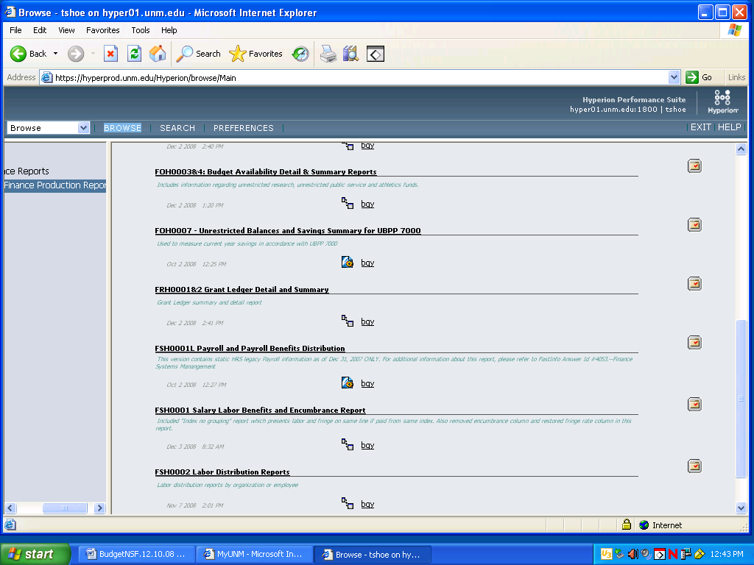
Budget Availability Reports
Notes:
Can be found in the Finance Production Reports folder.

Slide 12
Notes:
To find your level 5 org, if you only know the beginning of the code, put in the beginning, followed by a % sign. Then select “Find”. All the level 5 org codes with that beginning will be listed. Select the correct one. Here, 997A was selected.
Now we are going to generate a listing of funds in deficit for 997A: Pediatrics Level 5. After you (1)”Select Values” and select from the (2)”Reports Available”, click (3)“Generate Report”.

Slide 13
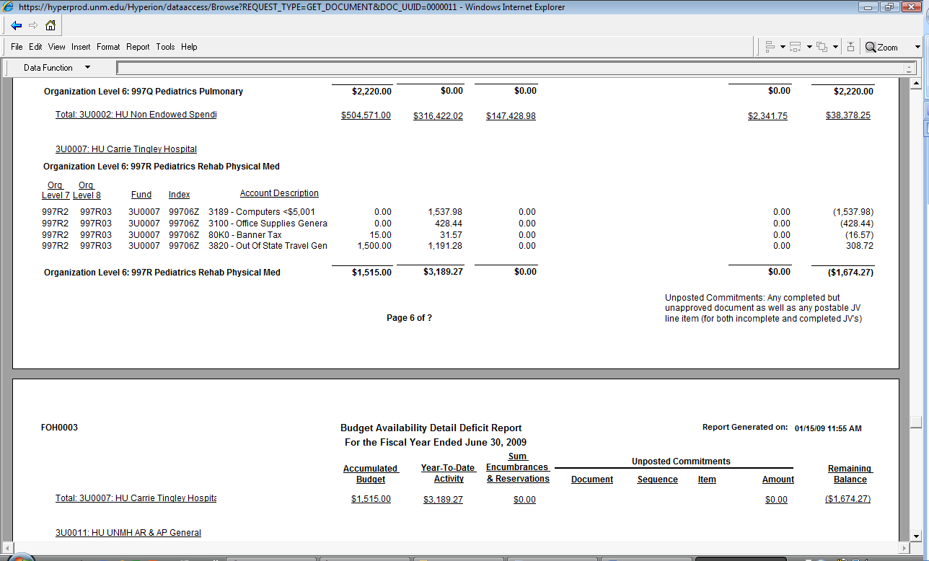
This is page 6 and 7 of the report.
Notes:
This is page 6 and 7 of the report. In this example, you can see that under Fund 3U0007, Org 997A is in deficit at Organization Level 5, fund level 3 for fund 3U0007.

Slide 14
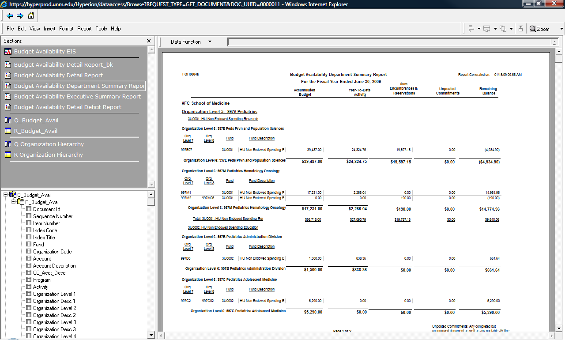
If you select View, and then select Section Catalog, a menu on the left appears.

Slide 15
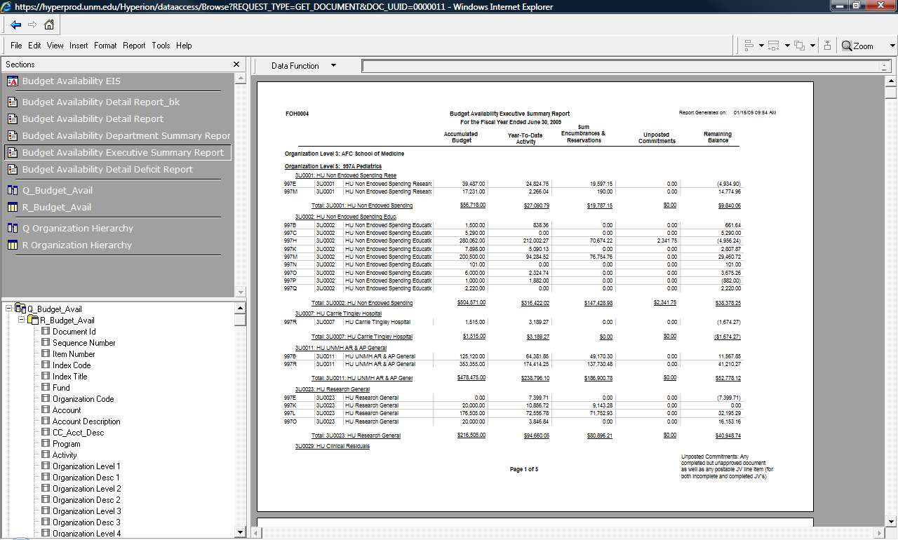
Notes:
You can then look at the information you ran (in this case, 997A, Level 5) in different formats without re-running the report. Here is an example of the executive summary report.

Slide 16
Hyperion Report FSH0002:
Labor Distribution Report
This report can be found in the Finance Production Reports folder, and will allow you to verify whether the organization labor distributions are current and accurate.
Banner Form FGIBAVL
Budget Availability Status Form – allows you to query by index code or specific Fund/Organization combination and check the available balance at org level 5 and fund.

Slide 17
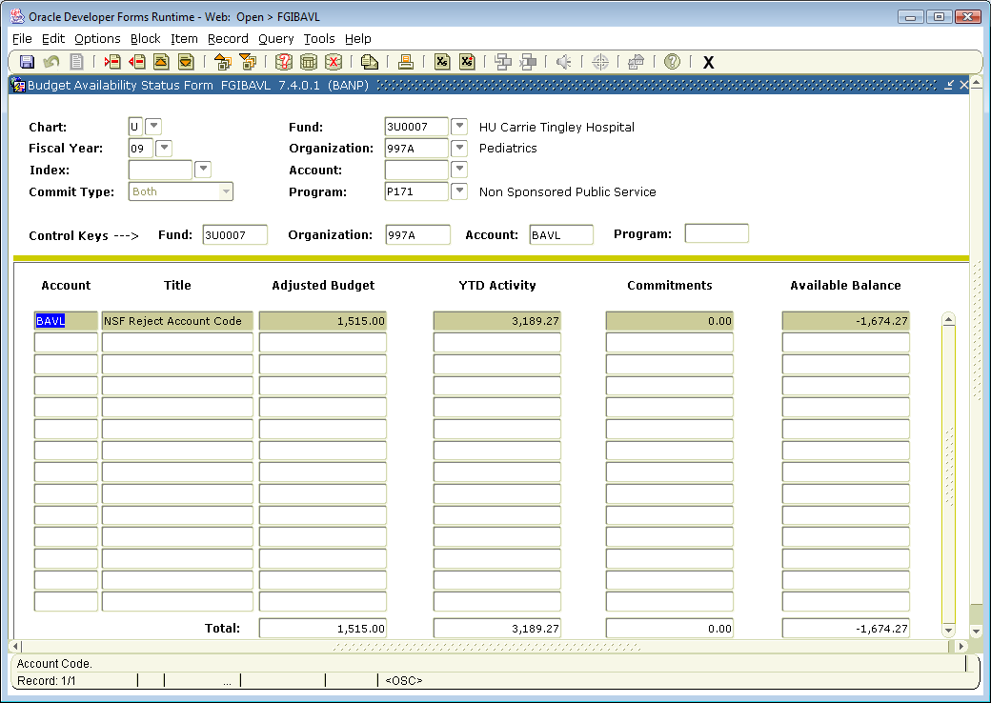
FGIBAVL shows you Available Balance
Notes:
To query, select F7, input the Fund and Organization numbers, and select F8.
The fund for this example is 3U0007, a level 3 fund. This is the one we looked at on pages 6&7 of the FORH0003 report, in the previous example. The Level 5 Organization is 997A, from our original report query. FGIBAVL shows you in one line the available balance at org level 5 for this level 3 fund.
You can see that this fund has $1,515 budgeted, and so far this fiscal year has spent $3,189.27. There are no commitments, so the fund 3U0007 for Pediatrics Level 5 Org (997A) is in deficit spending of $1,674.27.

Slide 18
Banner form FGIBDST, Organizational Budget Status Form – allows you to query by index code and check the available balance.
FGIBDST shows you Available Balance for an index or fund.

Slide 19
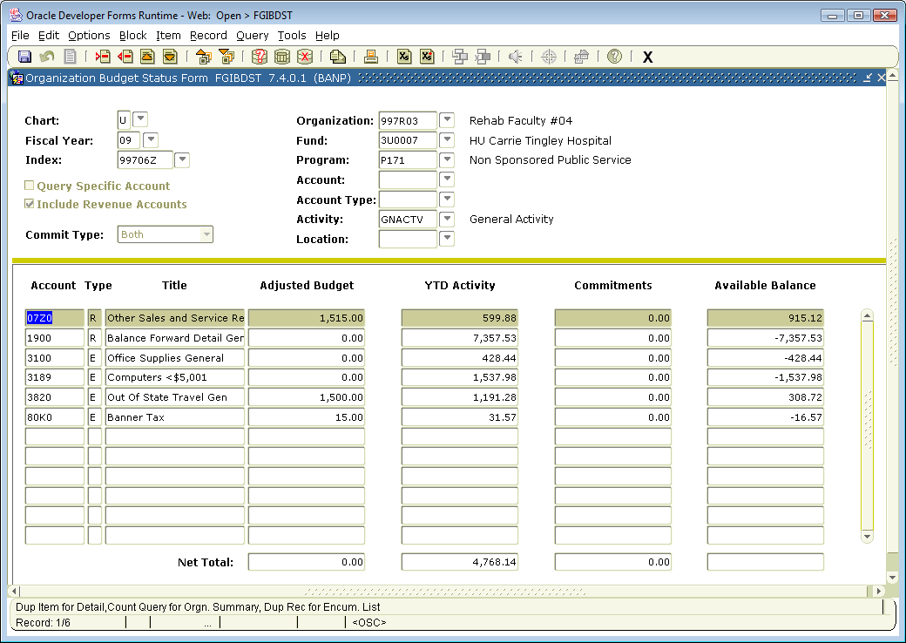
Notes:
Input the index number and select “next block”.
The index in this example is the same one on pages 6&7 of the FORH0003 report, in a previous example. This gives you an account breakdown. The expense accounts [-428.44, -1537.98, 308.72, -16.57=1,674.27] add to the same total.

Slide 20
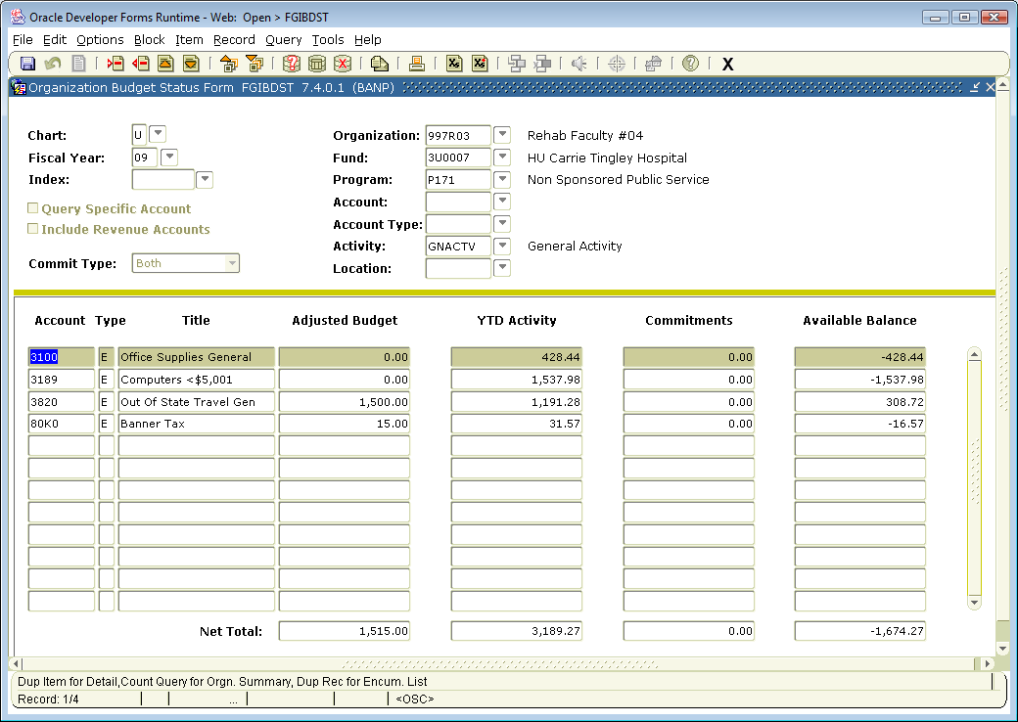
By unchecking the “Include Revenue Accounts” box, this form will give you fund results, as below:
Notes:
Again, the available balance shows the level 3 fund 3U0007 is in deficit by $1,674.27.

Slide 21
Avoiding NSF
Accurately budget within Banner all your current unrestricted indices.
Timely reconcile all indices to verify that expenses are complete and accurate (especially transactions that are uploaded to the banner system bypassing central accounting approval).
Since salaries comprise about 80% of most budget, verify labor distribution and reconcile salary changes on a timely basis.

Slide 22
Avoiding NSF
Process Salary Reallocations and Labor Distribution changes in a timely fashion.
Review outstanding Purchasing Orders for need and appropriateness.
Process any necessary PO Modifications in a timely manner.
Renew master Purchase Orders on a fiscal year basis.

Slide 23
Avoiding NSF
Liquidate manual encumbrance as soon as transaction has been completed/posted to Banner. [This does NOT happen “automatically”!]
Budget reserves amounts that the unit intends to spend in the current fiscal year.
Purge any pending transactions from Banner system that were initiated but are no longer intended to be completed.

Slide 24
Trouble Shooting NSF
Do I have PO’s that span more than one fiscal year?

Slide 25
Trouble Shooting NSF
Banner looks at the remaining amount on a purchase order and assumes it will be spent in the current fiscal year.
Example: You have a five year purchase order in place for $5,000, and intend to spend $1,000 per year, and only budget $1,000 in Banner. Banner subtracts the entire $5,000 from your budget, leaving you $4,000 overspent.
Modify multiyear purchase orders with a PO Modification form. Each purchase order should reflect what is to be spent in the current fiscal year.

Slide 26
Trouble Shooting NSF
Are my labor distributions current and accurate?

Slide 27
Trouble Shooting NSF
Reconcile your indices monthly. Labor Distributions can be updated with an EPAF, which you will access through Loboweb. Once the EPAF is approved and posted, the labor distribution will post correctly for future payrolls.
Labor redistributions are made with PZAREDS. This is how you correct already posted labor that is not in the correct index.
Notes:
In order to originate EPAFs, you must have taken EPAF-BAN HRP EP 101 course offered via Learning Central and submitted a BAR named “Originating a Labor Distribution EPAF” to originate an EPAF in Loboweb. Encumbrances for payroll are adjusted when posted, so you may not see your adjustment immediately.
You must have taken the PZAREDS course offered via Learning Central and submitted a BAR named “Department Labor Redistributions” to access PZAREDS in Banner.
Once your PZAREDS is posted, the incorrect transactions will be moved, along with related benefits, to the correct index. Please note that labor redistributions do NOT impact encumbrances.

Slide 28
Trouble Shooting NSF
Are my expenses properly charged?

Slide 29
Trouble Shooting NSF
Reconcile your indices monthly.
See the LEARNs posted at http://hsc.unm.edu/financialservices/accounting/learn.shtml entitled, Index Reconciliation Fundamentals, and Intermediate Index Reconciliation for assistance.

Slide 30
Trouble Shooting NSF
Banner feeds.
Banner feeds will post whether you are in NSF or not. This includes ITS (Telecom) charges. These can put you into NSF.

Slide 31
Trouble Shooting NSF
Unbudgeted reserves
. Any reserves that you wish to spend in the current year must be budgeted.
If you have a reserves amount budgeted, it will be budgeted in account 1901.

Slide 32
Trouble Shooting NSF
Unbudgeted Reserves
If necessary, submit a budget revision, documenting how you are going to spend the reserves. To submit a budget revision, you will submit a journal voucher with journal type BD4. Once this journal voucher is approved and posted, the entry should relieve your NSF status.

Slide 33
Trouble Shooting NSF
Pending Transactions?
When calculating NSF, Banner subtracts all outstanding JVs, DPEZs and Purchase Requisitions. Banner subtracts these whether they are posted or pending. If you have documents in existence that will never be posted, remove them.

Slide 34
Trouble Shooting NSF
Removing Pending Transactions
Document to Purge | Form to Use | How to Purge
Journal Voucher | FGAJVCQ | Record/Delete , twice
DPEZ | FZADPEZ | Record Remove, twice
Purchasing Requisition Part 1 | FOADOCU | Delete the completed purchasing requisition [Note: this is only for pending reqs. Completed reqs are handled with a PO mod.]]
Purchasing Requisition Part 2 | LoboMart | Remove purchase requisition

Slide 35
Trouble Shooting NSF
Is NSF due to another Index?
Your index is not in NSF
You are getting NSF indicators
Another index within your organization could be the cause.
Notes:
Check the available balance of your department using Banner Form FGIBDSR, the Executive Summary Form. This form allows you to query by specific Organization to check the available balance. If your organization as a whole is NSF, all indices within the organization will be in NSF status. Discuss the situation with your supervisor.

Slide 36
Quick Reference Guide
Budgeting Questions:
Main Campus:
…………………..…………………………………… 277-6465
HSC Campus:
……………………………………………………….. 272-2885

Slide 37
Quick Reference Guide
Unrestricted Accounting Questions:
Main Campus:
………………………………………………………… 277-2018
HSC Campus:
………………….……………………………………… 272-6264

Slide 38
Quick Reference Guide
Payroll Encumbrance Questions:
Financial Services Support Center…………….. 277-3457
EPAF Questions:
HRPR Support Center………………………….…….. 277-3457

Slide 39
Quick Reference Guide
websites
HSC Budgeting: http://hsc.unm.edu/about/budget/
Main Campus Budgeting: http://www.unm.edu/~budget/
Unrestricted Accounting HSC: http://hsc.unm.edu/financialservices/accounting/
Unrestricted Accounting Main: http://www.unm.edu/~gacctng/
Contract & Grant Accounting HSC: http://hsc.unm.edu/financialservices/postaward/

Slide 40
Quick Reference Guide
Websites
Contract & Grant Accounting Main: http://www.unm.edu/~cgacctng/
Financial Services Support Center: http://www.unm.edu/~fssc/index.html
Fast Info: http://fastinfo.unm.edu/v0508/index.php

Slide 41
Quick Reference Guide
Other
LEARN Material:
HSC Campus: http://hsc.unm.edu/financialservices/accounting/learn.shtml (includes LEARN Schedule of upcoming topics , past manuals and past Power Point presentations)
Main Campus: http://www.unm.edu/~fssc/index.html (select “Banner Bytes” on the left. You will find many presentations, including the LEARN presentations)

Slide 42
Quick Reference Guide
Other
Financial Services Support Center: [ http://www.unm.edu/~fssc/index.html ]
On the left, select:
Banner Bytes- contains many helpful Presentations, including all the LEARN presentations
Job Aides- helpful “how to’s”, for completing Finance specific tasks

Slide 43
Quick Reference Guide
Other
Financial Services Support Center: [ http://www.unm.edu/~fssc/index.html ]
On the left, select:
Participant Guides- the most current guides used in EOD classes
Forms- direct links to Financial Services Forms

Slide 44
Quick Reference Guide
ITS Help:
http://its.unm.edu/support/index.html this site lists phone numbers for help desks on Main Campus, HSC Campus, the Hospital, and others. It has a direct link to Fast Info. It lists several other ways to get technical support, all on the main page.

Slide 45
Questions?

