Slide 1
Provider Handoff Recommendations June 28th, 2011

Slide 2
Why Are We Doing This?
ACGME is mandating that all residency programs “monitor and ensure effective, structured handover processes in order to facilitate both continuity of care and patient safety”
TJC 2008 National Patient Safety Goals requirement regarding standardization of handoffs
Results of our own in house survey that demonstrated resident & faculty dissatisfaction with current process along with patient safety

Slide 3
Results – Handoff Satisfaction UNM
54 % responded Disagree
62 % responded Strongly Disagree or Disagree

Slide 4
Results - Negative Outcome UNM
42% responded Once Every Few
57% responded 1-2 times per handoff or Once every Few
Notes:
18/42 = 42%
18+6/42 = 57%

Slide 5
Results - Negative Outcome Pres
53% responded Once Every Few
84% responded Once every 10 or Rare Occurrence

Slide 6
When?
The new handoff process will officially go into effect July 1st, 2011
Changes to the handoff process will be a dynamic process and will occur throughout the year
Final recommendations will be made on July 1st, 2012

Slide 7
Background
Handoff survey was sent to the residents and faculty at UNM in March, 2011
Sklar, McLean, Crandall & Heilman
Handoff process team was then created to implement changes to standardize the process
Sklar, McLean, Webb, Heilman & Lahr
Recommendations are based on the most up-to-date research on ED based handoffs and the UNM ED based survey done earlier this year

Slide 8
What are the changes?
Preparation for Handoff
“Run the List” within the hour leading up to the shift change with the attending
Re-evaluate high-risk patients within the hour leading up to handoff
Write down key lab values for acutely ill and complicated patients within thirty minutes of handoff

Slide 9
What are the changes?
Handoff – PLAN ED
Patient (age, sex, name, room number and chief complaint)
Label with working diagnosis or differential diagnosis
Assessment (key elements of history, physical exam, labs, diagnostic imaging)
Next steps and nursing assessment (pending labs, diagnostic imaging, consultants)
Everything else (social issues, handed off before, systems issues)
Disposition

Slide 10
What are the changes?
Handoff – General Guidelines
Be on time and prepare for handoff early so that handoffs can start when scheduled
Organize handoffs by doing selected “bedside waking rounds”
Minimize interruptions!
Officially admitted patients
Spend approximately 5 minutes on clinical teaching
Notes:
(have bed request and orders) should have a very brief handoff by the outgoing resident to the accepting attending; if the patient had admitting orders at the time of the previous handoff the outgoing attending provides the handoff to the accepting attending.

Slide 11
What are the changes?
Post Handoff
Within 15 minutes of the end of handoff, the accepting resident should assign himself or herself as the resident provider in the FirstNet tracking system
Within the first 2 hours of the shift, patients that were handed off should have had their chart, laboratory and other findings reviewed and the resident should have physically introduced himself or herself

Slide 12
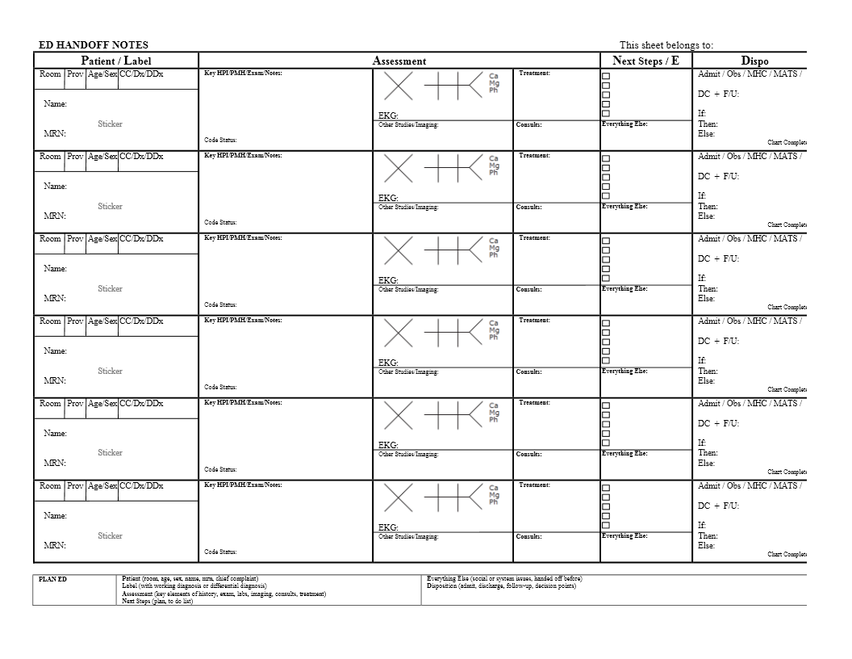
What are the changes?

Slide 13
Next Steps
Try out the new recommendations during the month of July
Will have a discussion session on July 27th at Wednesday conference for feedback and suggestions
Works in progress…
Nursing involvement in handoff process
Electronically generated handoff sheet

Slide 14
QUESTIONS?

